Slide 1
TECHNICAL & BUSINESS WRITING
Department of Computer Science
Lecture by Ms. Maryam Ali Khan

Slide 2
WHAT IS A MANUAL?
A manual is a book or pamphlet that contains information about a program or piece of hardware.

Slide 3
WHERE ARE MANUALS USED?
A computer case may come with documentation explaining what sizes of motherboard it can hold.
A video game may come with a manual explaining how to play it.

Slide 4
TYPES OF MANUALS
1. Product Manual
This is also called the “Instruction manual”. It is a manual that instructs users how to use the product.
2. Installation Manual
This is a manual on how to set- up or install the product.
3. Troubleshoot Manual
A type of manual used to fix parts of the product.
4. User Manuals
A type of manual that focuses on different kinds of users- administrators, maintenance personnel, beginners, managers, or students.
5. Operations Manual
This is the manual for operations of the company or businesses. It is a set of standards and procedures for operations, work standards, and policies of the company.
6. Crisis Management Manual
A manual on how to respond to crisis or tragedies such as earthquake, fire, storms, tsunami, or violence in the work premises.
7. Audit Manual
This type of manual is a guide on how to do or make finance reports in relations to accounting and auditing matters.

Slide 5
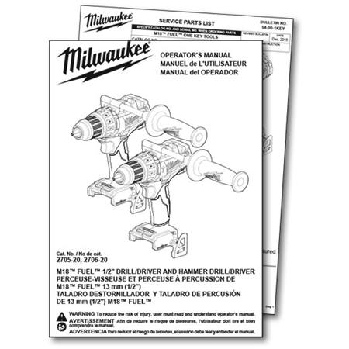
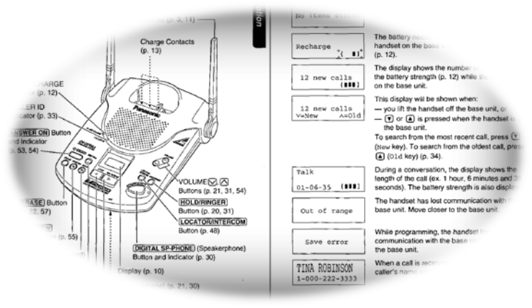
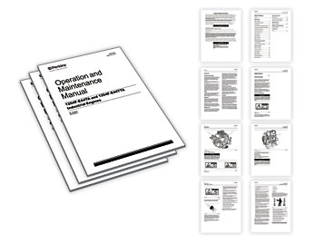

Slide 6
TIPS FOR WRITING A MANUAL
Define Your Audience
  know your reader
  What is their experience level?
  optimize your instructions to match their expertise
Describe the Problem
  Explain the problem your manual aims to solve
  present the solution
  then outline the instructions in order to attain the solution
Break it Down
  If the problem addressed in the manual is particularly complex, break it down into smaller parts.
  List each section with specific instructions.
Be Descriptive
  Vague words like "thing," "part," and "stuff" lead to ambiguous repair manuals.
  If you don't know what something is called, do your best to identify it by looking online or asking someone

Slide 7
Take Awesome Photos
  Taking quality photos doesn’t demand expensive equipment
Avoid Using the First Person
  You have a more authoritative tone of voice by not using statements such as "I did this" in your manuals.
Use a Template
  Things like consistent bullet-point styles, image sizes, and text orientation can help make browsing and following along easier for your readers.
Minimize Background Info
  A little background information is great but over doing it may lead to loss of the main idea.
Be Simple
  People will not use your manual if they cannot understand what you're talking about, it isn’t Shakespeare.

Slide 8
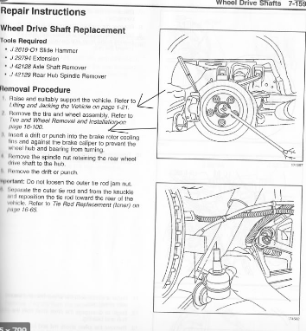

Slide 9
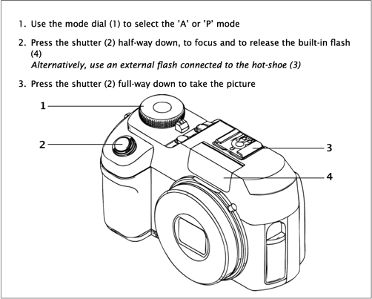

Slide 10
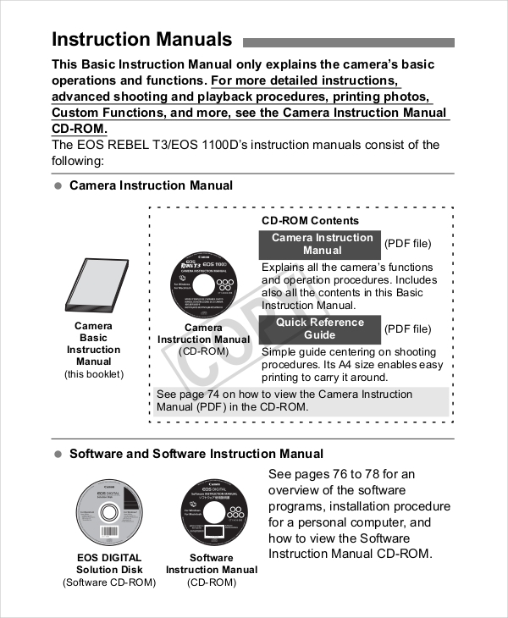

Slide 11


Slide 12
DIFFERENCE
BETWEEN
LEAFLET AND BROCHURE
The key difference between brochure and leaflet is their purpose;
  brochures are only used to promote companies, their products and services
  leaflets can also be used to inform and educate the general public.

Slide 13
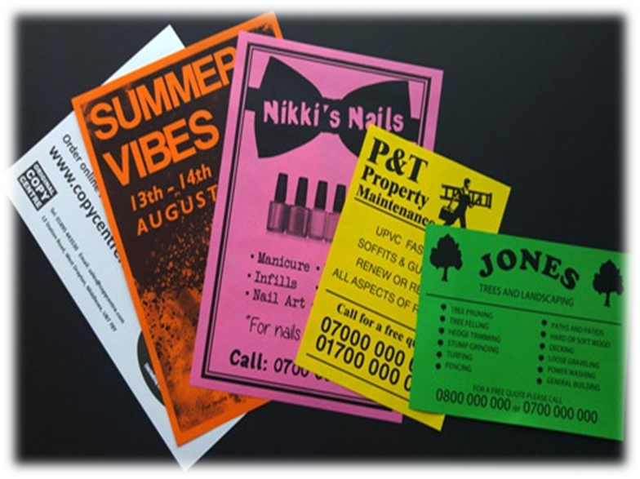

Slide 14
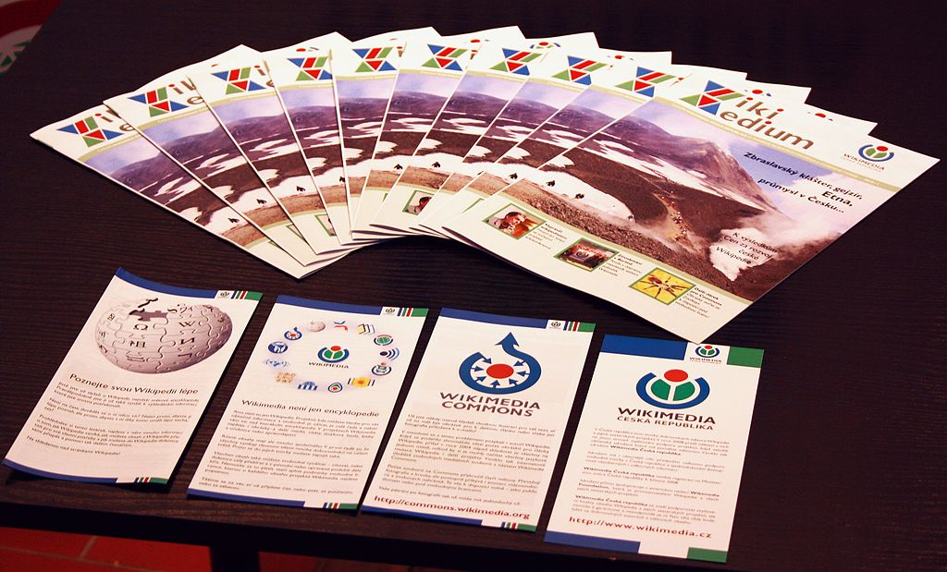

Slide 15


Slide 16
BROCHURES
A brochure is an informative paper document for advertising, which can be folded into a template, pamphlet or leaflet

Slide 17
WHERE ARE BROCHURES USED?
Brochures are promotional documents, primarily used to introduce company, organization,
products or services and inform potential customers or members of the public of the benefits.

Slide 18


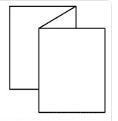
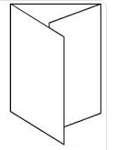
TYPES OF BROCHURES
Bi-fold (single sheet printed
on both sides and folded into halves)
Tri-fold (the same but folded into thirds)
Z-fold
C-fold

Slide 19
WHAT TO INCLUDE IN A BROCHURE?
Decide on a purpose or theme:
  Is it focusing on an event?
  Telling about a company?
  Providing information about a social program?
Choose information to go in the brochure:
  Include main points only
  Small in size so cant fit everything
Be concise:
  Decide how to say things in a short manner
Use bullets:
  Use bulleted list as an easy-to-read way of presenting information

Slide 20


Slide 21
FLYER
A leaflet or flyer , also called a circular or handbill, is a form of paper advertisement intended for wide distribution and typically posted or distributed in a public place.

Slide 22
WHO USES FLYERS?
Promote a good or service, such as a restaurant or a gathering hall.
Persuade or send a social, religious, or political message, as in political campaign activities on behalf of a political party or candidate.
Advertise an event such as a music concert, gathering appearance, festival, or political rally.

Slide 23
WHY USE FLYERS?
Inexpensive to produce.
form of mass marketing or communication
their widespread use intensified with the spread of desktop publishing systems.

Slide 24
TYPES OF FLYERS
Persuasive: attains its objective through use of reason. Facts are presented so that the audience is convinced that the conclusions reached are valid.
Informative: it is factual. In presenting facts previously unknown to the audience, it attracts a reading public by satisfying curiosity.
Directive: directs action when intelligence indicates the target is receptive. It is used to direct and control activities of underground forces.

Slide 25
FLYER COMPOSITION
Typography: Although leaflets generally are small, they should contain comparatively large print, particularly when directed toward the audience.
Colour: A judicious use of colour is important in the appearance of the leaflet. The number of colours available will be limited by the type of printing equipment available.
Photographs: Photographs often are used as documentary proof of particular incidents or events.

Slide 26
Cartoons and Drawings: When done in a manner appealing to the target audience, are invaluable assets in supporting the theme of a leaflet, may attract the eye; they help to present a more attractive format.
Format Symmetry: Headlines, subheadings, photographs, cartoons, drawings, captions, and text should be so arranged as to present an attractive and symmetrical appearance.

